Slide 1
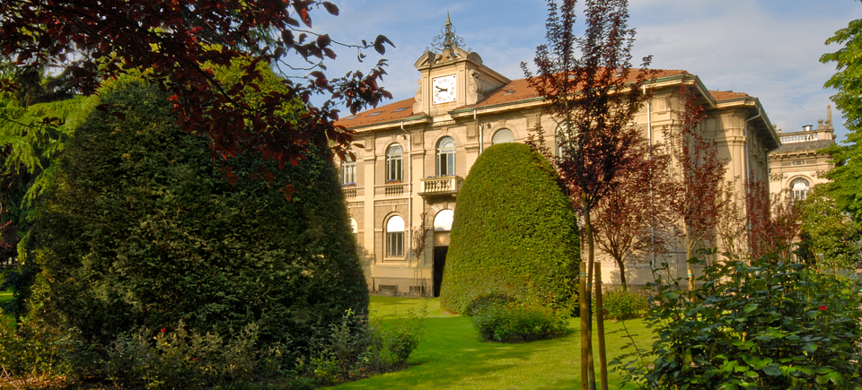

Titolo presentazione sottotitolo
Comparison between
different approaches for Land
Cover classification
Milano, XX mese 20XX
Geoinformatics Engineering
Student: Yuxin Chen
Advisor: Ludovico Giorgio Aldo Biagi
Co-advisor: Nikolina Zallemi

Slide 2
Overview
Aim of the Study
Introduction
Workflow
Study Areas
Data Processing
Results
Conclusions
Yuxin Chen

Slide 3
1. Aim of the study
To evaluate and compare the performance of different machine learning algorithms for land cover classification using Sentinel-2 multispectral imagery.
Algorithms Comparison:
KMeans , Random Forest, and Multi-Layer Perceptron
Multi-Regional Validation:
urban (Shanghai), agricultural (Tuscany), alpine (Val d'Aosta)
Sampling Strategy Optimization:
Compare proportional vs. uniform sampling strategies
Yuxin Chen

Slide 4
2. Introduction：Earth Observation
Global issues like climate change and urban growth make continuous Earth monitoring important.
EO uses satellites and aircraft to collect surface data at different scales and times.
Multispectral remote sensing helps map land cover, monitor vegetation, and study cases.
Each land-cover type reflects spectrum differently. (e.g., vegetation: low red, high NIR → NDVI).
Yuxin Chen

Slide 5
2. Introduction：Machine Learning
Traditional methods often fail with complex and mixed land types.
Machine learning finds patterns automatically from data.
It improves accuracy and works well in different regions.
Yuxin Chen

Slide 6
2. Introduction：Algorithms
Type | Algorithms | Core Idea | Platform
Unsupervised | K-Means | Clusters pixels based on spectral similarity without using labeled data. | GEE ee.Clusterer.wekaK-means
Supervised | Random Forest | Combines multiple decision trees to achieve robust and interpretable classification. | GEE ee.Classifier.smileRandomForest
Supervised | Multi-Layer Perceptron | Uses interconnected neural layers to learn complex nonlinear spectral relationships. | Python scikit-learn
Earth Observation
Yuxin Chen

Slide 7
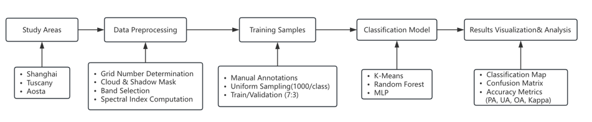
3. Workflow
Yuxin Chen

Slide 8
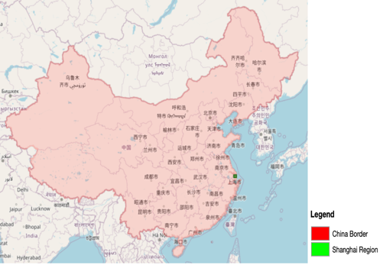
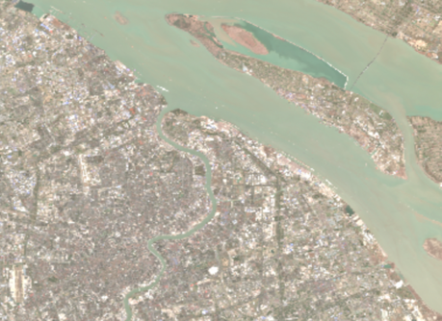
4.1 Study cases——Shanghai
The study area is located in the eastern part of Shanghai, China, with grid number 51RUQ, covering an area of about 50km x 40km. The data were collected on February 27, 2022.
The area is dominated by a large number of built-up areas with typical urbanization features.
Yuxin Chen

Slide 9
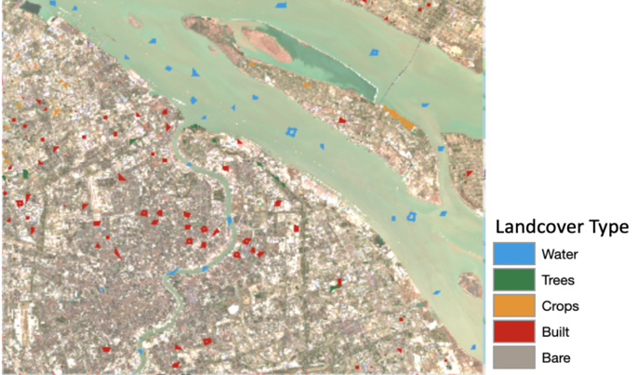
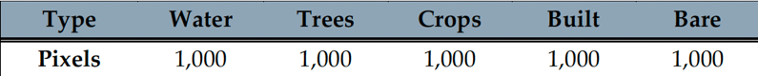
4.1 Study cases——Shanghai
Yuxin Chen

Slide 10
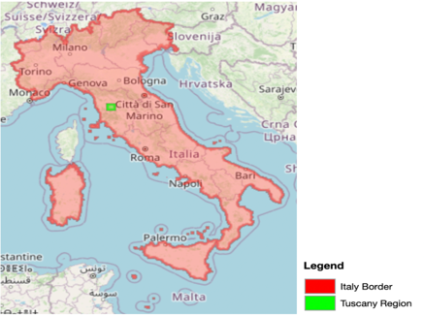
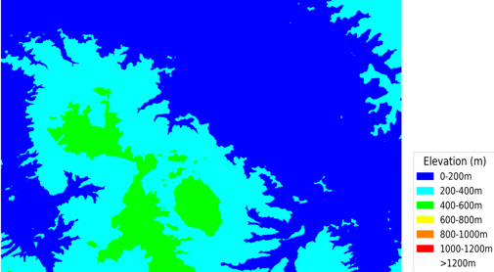
4.2 Study cases—Tuscany
The study area is located in the northwestern part of Tuscany, Italy, with grid number 32TPP, covering an area of approximately 25 km x 20 km, and the data were collected on April 18, 2022.
The area consists mainly of agricultural land, dominated by trees and crops, showing a typical agricultural landscape of the Tuscan region.
Yuxin Chen

Slide 11
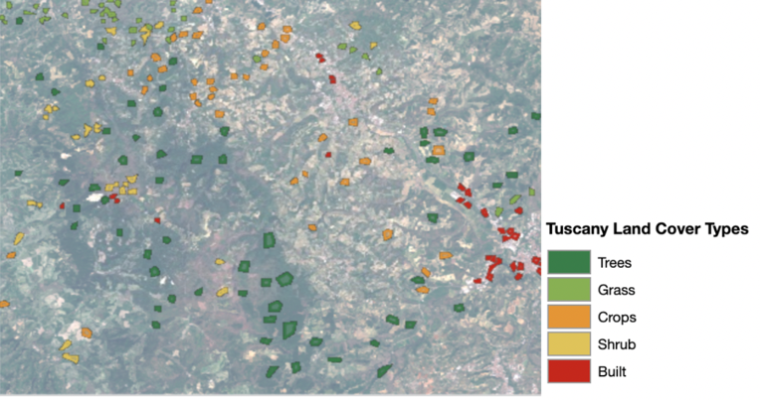
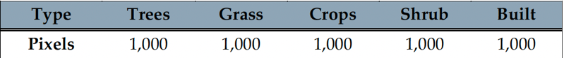
4. 2 Study cases—Tuscany
Yuxin Chen

Slide 12
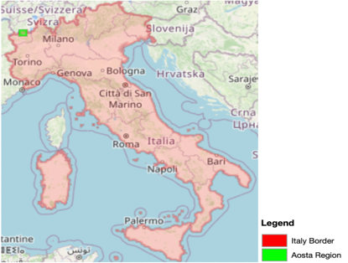
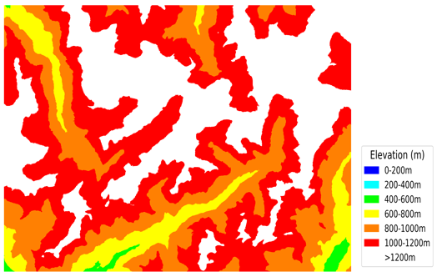
4.3 Study cases—Aosta
The study area is located in the northern part of the Aosta Mountains, Italy, with the grid number 31TGL, covering an area of approximately 25 km x 20 km. The data were collected on October 6, 2022.
Due to the high altitude and mountainous climatic characteristics, a lot of snow cover can be seen, and a small amount of bare ground can be observed more clearly.
Yuxin Chen

Slide 13
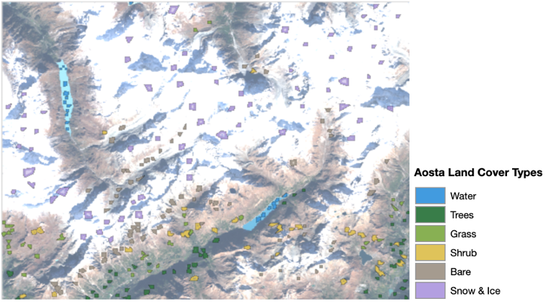
4.3 Study cases — Aosta
Yuxin Chen

Slide 14
5. Data processing
Grid Number Determination
Cloud and Shadow Mask
Band Selection
Spectral Indexes Computation
Yuxin Chen

Slide 15
5.1 Grid Number Determination
When the study area does not match the grid extent, the image may be empty.
MGRS is a standard coordinate system used by NATO and is a square mile grid. It is based on the UTM grid, with each large UTM grid further divided into smaller squares of 100 km * 100 km.
Example：
Shanghai study area is 51RUQ ：
51：Indicates the UTM area code.
R：Indicates the latitude zone.
UQ：100km × 100km grid number.
Tuscany：32TPP；
Aosta：31TGL；
Yuxin Chen

Slide 16
5.2 Cloud and Shadow Mask
Identify tile ID covering the study area.
Load candidate images in Google Earth Engine (GEE) within the target period.
Extract cloud cover (%) from metadata (CLOUDY_PIXEL_PERCENTAGE) and rank images.
Manual inspection of candidate images using GEE visualization, checking cloud location, shadow extent, and feature clarity.
Select best image: choose one high-quality, cloud-free scene as the classification source.
Yuxin Chen

Slide 17
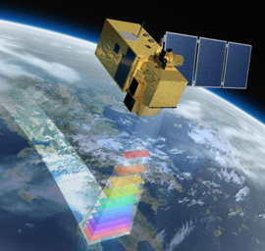
5.3 Band Selection
10 bands from Sentinel-2:
10 m: B2–B4 (Blue, Green, Red), B8 (NIR)
20 m: B5–B7 (Red Edge), B8A (Narrow NIR)
B11–B12 (SWIR)
Water: high Blue/Green, low NIR/SWIR
Built/Bare: strong contrasts in Red, NIR, SWIR
Vegetation: Red absorption, NIR + Red Edge for canopy details
Snow/Ice: high visible, low SWIR
Yuxin Chen

Slide 18
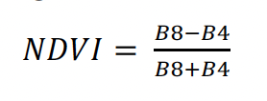
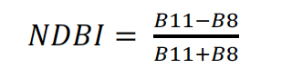
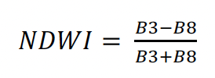
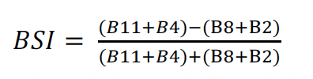
5.4 Spectral Indexes Computation
They were applied to better distinguish vegetation, water, urban, and bare areas.
Yuxin Chen

Slide 19
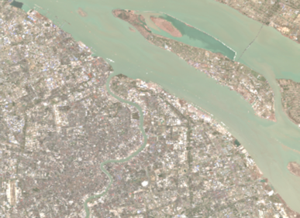
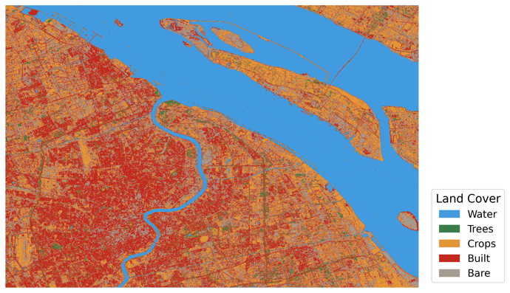
6.1 Results: Kmeans - Shanghai
Yuxin Chen

Slide 20
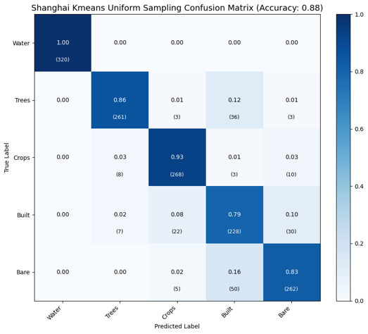
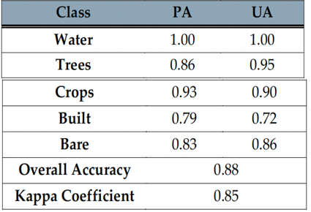
6.1 Results: Kmeans - Shanghai

Slide 21
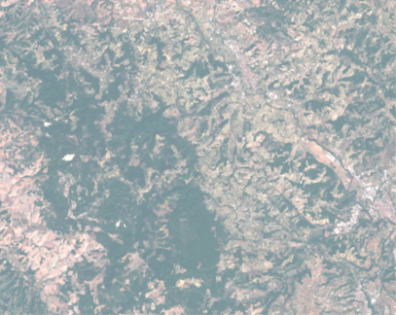
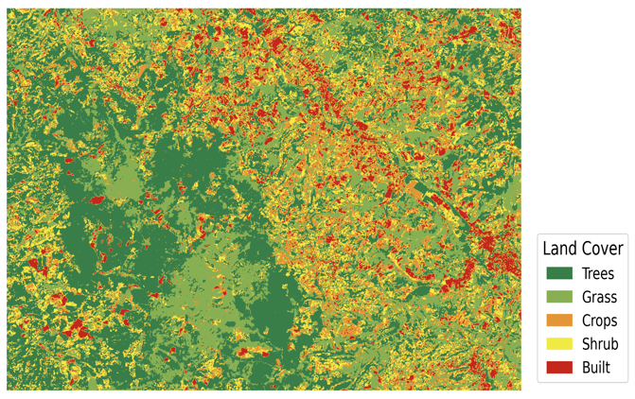
6.1 Results: Kmeans - Tuscany
Yuxin Chen

Slide 22
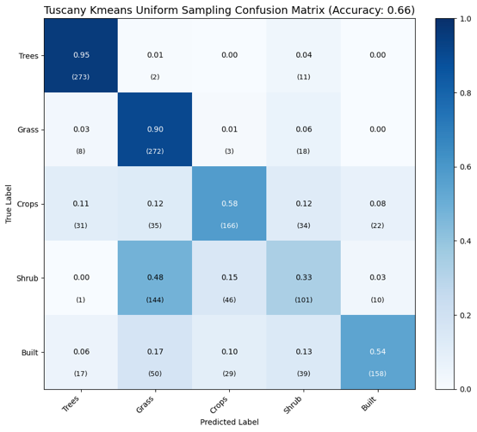
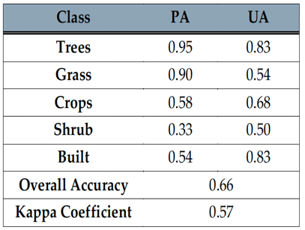
6.1 Results: Kmeans - Tuscany
Yuxin Chen

Slide 23
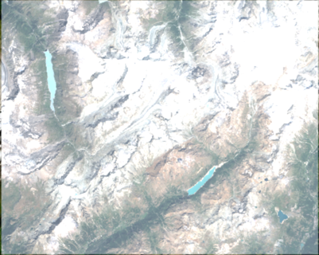
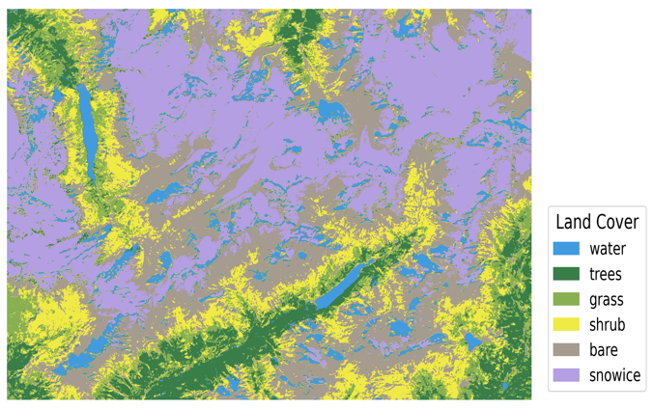
6.1 Results: Kmeans - Aosta
Yuxin Chen

Slide 24
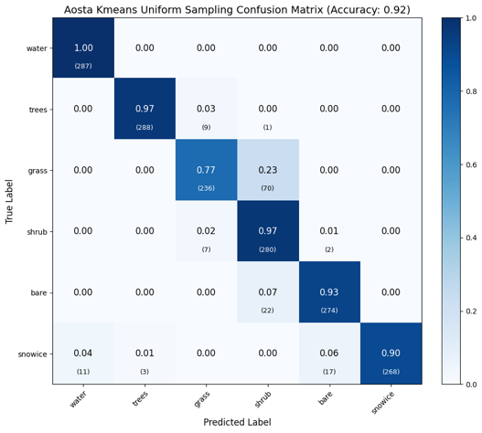
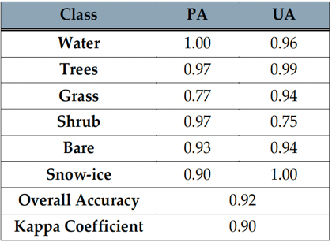
6.1 Results: Kmeans - Aosta
Yuxin Chen

Slide 25

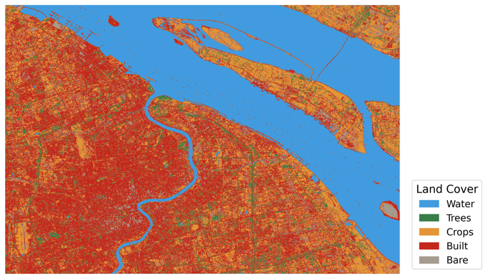
6.2 Results: RF - Shanghai
Yuxin Chen

Slide 26
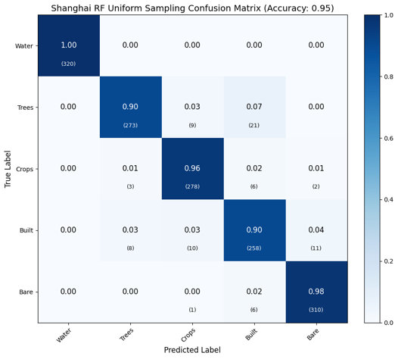
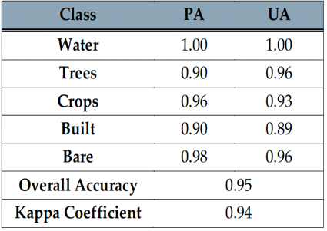
6.2 Results: RF - Shanghai
Yuxin Chen

Slide 27

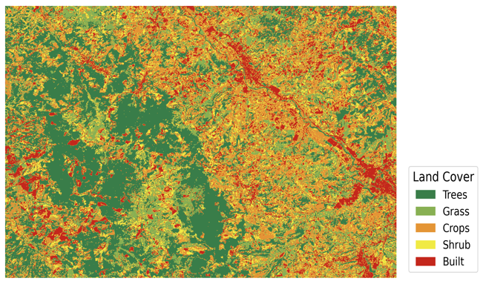
6.2 Results: RF - Tuscany
Yuxin Chen

Slide 28
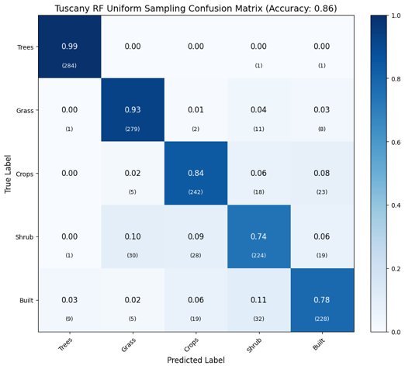
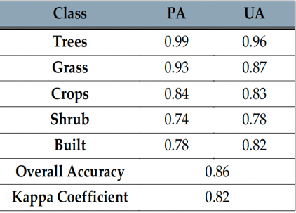
6.2 Results: RF - Tuscany
Yuxin Chen

Slide 29

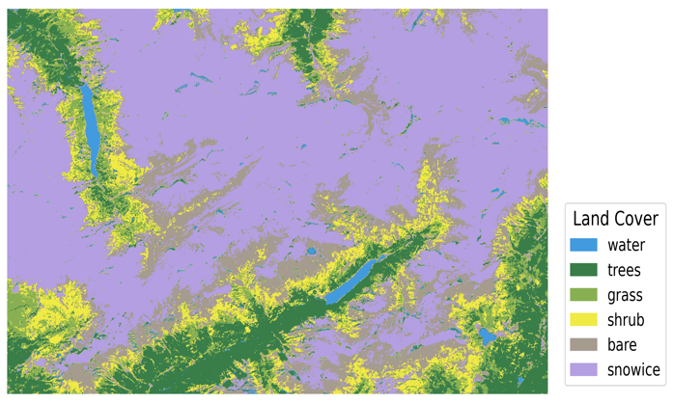
6.2 Results: RF - Aosta
Yuxin Chen

Slide 30
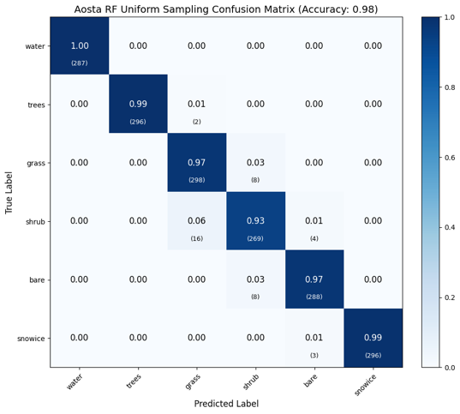
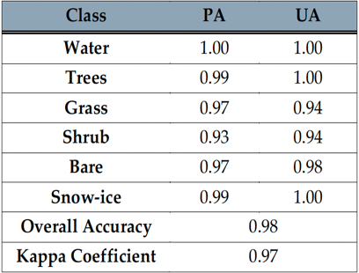
6.2 Results: RF - Aosta

Slide 31
6.3 Results: MLP - Parameter Tuning
GridSearchCV with 3-fold cross-validation was used to find the best MLP settings.
Four key parameters were explored:
activation (tanh / relu): adds non-linearity.
alpha (0.0001–0.05): controls regularization.
hidden_layer_sizes (50,50,50 / 100,50 / 128,64,32): defines network depth.
learning_rate (constant / adaptive): controls weight updates.
The best setup for each area was chosen based on validation accuracy.
Yuxin Chen

Slide 32
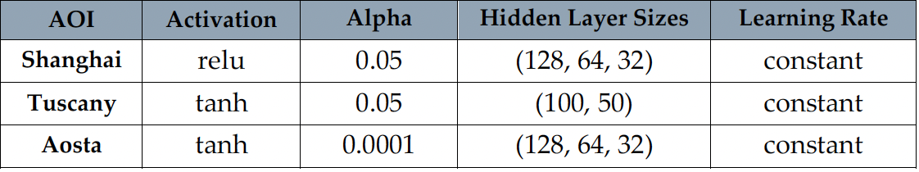
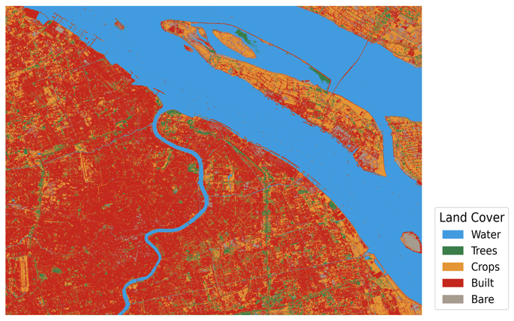
6.3 Results: MLP - Shanghai
Yuxin Chen

Slide 33
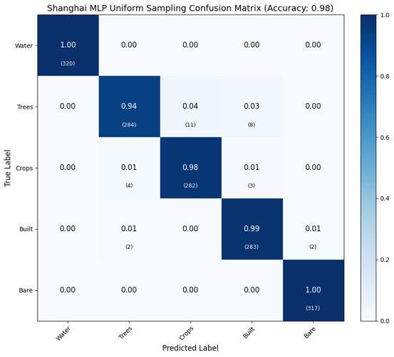
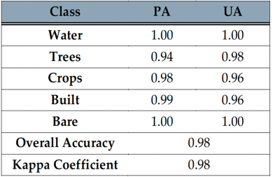
6.3 Results: MLP - Shanghai

Slide 34
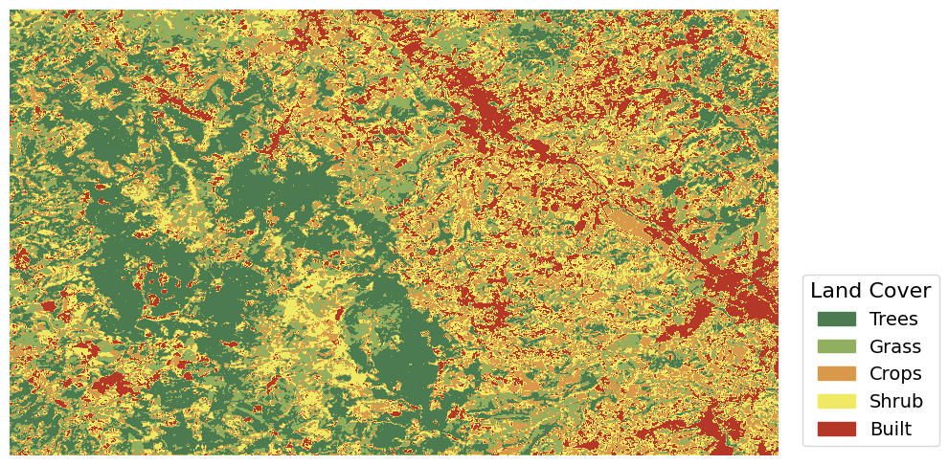
6.3 Results: MLP - Tuscany
Yuxin Chen

Slide 35

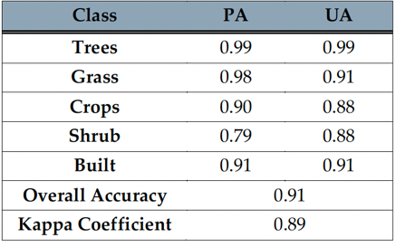
6.3 Results: MLP - Tuscany

Slide 36

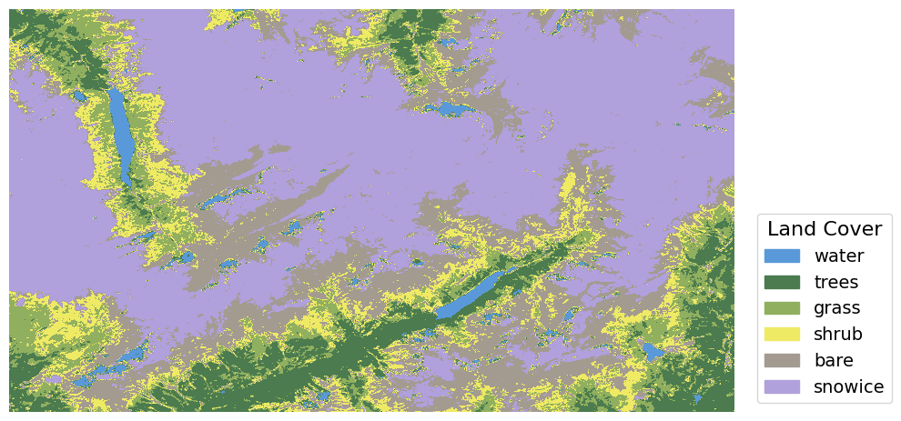
6.3 Results: MLP - Aosta
Yuxin Chen

Slide 37

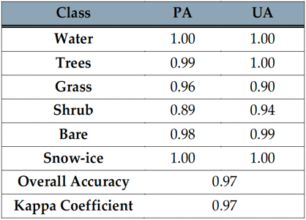
6.3 Results: MLP - Aosta

Slide 38
7. Comparison of Uniform and Proportional Sampling Strategies
Evaluate how different sampling strategies affect classification accuracy and feature recognition.
Strategy | Description
Uniform | Equal samples per class — balanced but artificial
Proportional | Samples follow real area ratios — realistic but imbalanced
Because of limited time, the comparative experiment was performed only using the Random Forest model.
Yuxin Chen

Slide 39

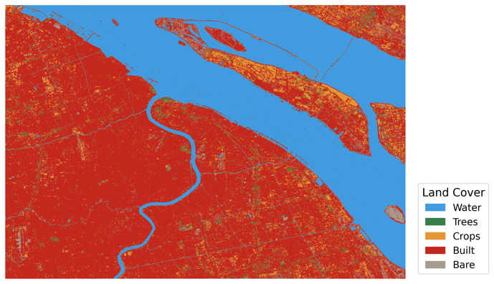
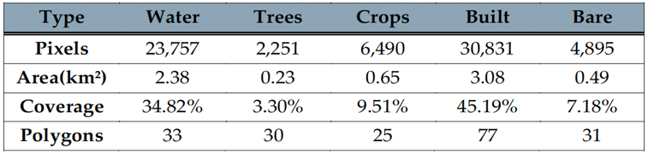
7.1 Proportional Sampling Strategies Shanghai —— Random Forest
Yuxin Chen

Slide 40
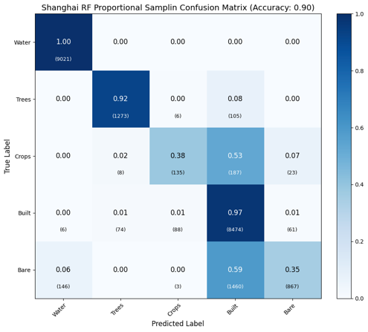

7.1 Proportional Sampling Strategies Shanghai —— Random Forest
Yuxin Chen

Slide 41



7.2 Proportional Sampling Strategies Tuscany —— Random Forest
Yuxin Chen

Slide 42


7.2 Proportional Sampling Strategies Tuscany —— Random Forest
Yuxin Chen

Slide 43



7.3 Proportional Sampling Strategies Aosta —— Random Forest
Yuxin Chen

Slide 44


7.3 Proportional Sampling Strategies Aosta —— Random Forest
Yuxin Chen

Slide 45
8. Conclusions —— Model Comparison
KMeans only captured coarse patterns, with much lower accuracy (e.g., Tuscany OA = 0.66).
RF performed reliably but with weaker boundary precision.
MLP achieved the best overall accuracy and spatial coherence (Shanghai: 0.98, Tuscany: 0.91, Aosta: 0.97), especially in distinguishing minority and transitional classes.
As expected, Supervised models (MLP, RF) outperform unsupervised KMeans.
Yuxin Chen

Slide 46
8. Conclusions —— Sampling Strategies
Uniform sampling markedly improved minority-class recognition compared to proportional sampling
(e.g., Grass in Aosta: 43% → 97%;
Crops in Shanghai: 38% → 96%).
Uniform sampling improves boundary details and class balance, making it better for mixed or complex terrains when used with RF.
Yuxin Chen

Slide 47

Firma convenzione Politecnico di Milano e Veneranda Fabbrica del Duomo di Milano
Thank you for your attention！
Student: Yuxin Chen
Aula Magna – Rettorato
Mercoledì 27 maggio 2015

